Slide 1


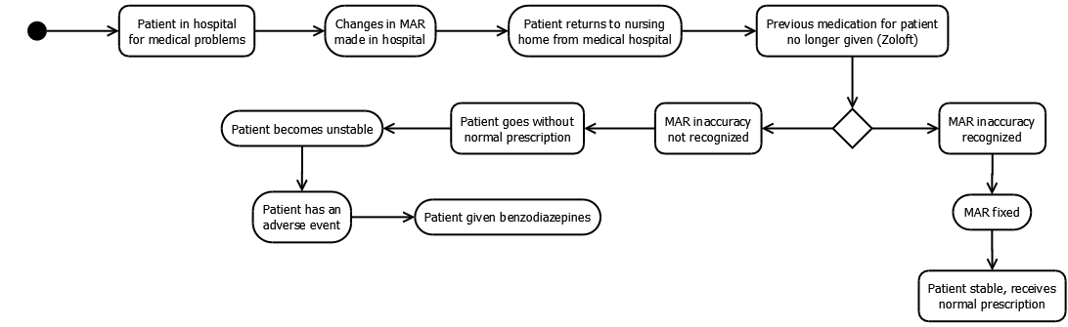
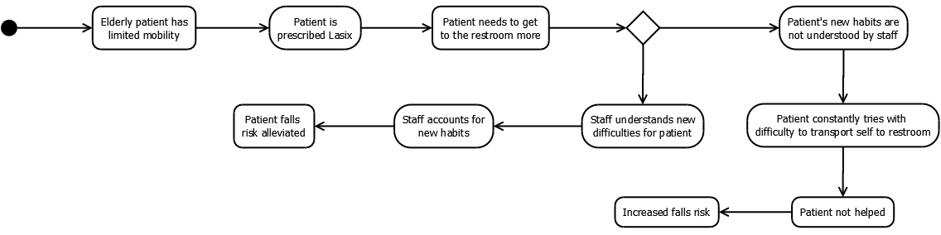
Toward an Informatics Intervention to Address
Medication Safety “Weak Spots” in the Nursing Home
Eric Chou, Richard D. Boyce
Department of Biomedical Informatics, University of Pittsburgh
Introduction
In the nursing home (NH) setting, circumstances may arise to put a patient at a higher risk for falls. Such risk may emerge through circumstances such as errors associated with the larger number of medications prescribed in older adults¹, a higher frequency of poorly executed transitions of care in older adults than in younger populations², and more. Toward the goal of preventing such errors in care, the primary objective of this study is to pinpoint specific vulnerabilities (“weak spots”) in the workflows for NH’s to inform the design of a clinical records-based intervention.
Results
The 6 weak spots chosen address sudden stoppage of medication, unintentional weight loss, patient history of vertical, patients taking diuretics while struggling with mobility, prolonged psychotropic exposure, and co-exposure to antibiotics and anticoagulants.
The UML diagrams for 2 of these selected weak spots - corresponding with sudden stoppage during a transition of care and exposure to diuretics while struggling with mobility - are presented below, along with tables depicting the data obtained through queries.
Conclusion & Future Work
Prevalence of exposure to these 6 weak spots can be surveyed through querying a retrospective dataset, and these vulnerabilities should be addressed to ameliorate circumstances that may potentially lead to an adverse event. These weak spots will serve as components for a falls prediction data set that will inform the design of a clinical records-based intervention.
References
1. Hanlon JT, Wang X, Castle NG, et al. Potential Underuse, Overuse and Inappropriate Use of Antidepressants in Older Veteran Nursing Home Patients. Journal of the American Geriatrics Society. 2011;59(8):1412-1420. doi:10.1111/j.1532-5415.2011.03522.x.
2. Coleman, E. A. (2003), Falling Through the Cracks: Challenges and Opportunities for Improving Transitional Care for Persons with Continuous Complex Care Needs. Journal of the American Geriatrics Society, 51: 549–555. doi: 10.1046/j.1532-5415.2003.51185.x
3. 1. Morris J, Fries B, Morris S. Scaling ADLs Within the MDS. The Journals of Gerontology Series A: Biological Sciences and Medical Sciences. 1999;54(11):M546-M553. doi:10.1093/gerona/54.11.m546.
Data Sources
Weak spots were derived using 20 semi-structured interviews on NH clinicians’ perceptions of medical safety. These interviews were conducted with staff members at three Western Pennsylvania nursing facilities.
Retrospective observational data from de-identified patients residing in five skilled nursing facilities in Western Pennsylvania was used from the Minimum Data Set for Nursing Homes (MDS 3.0), covering the time period from October 1, 2010 to January 31, 2014.
This mixed methods study primarily uses these two data sources to investigate vulnerabilities in the NH clinical workflow.
 | Canterbury |  | Heritage |  | Cranberry |  | Seneca |  | Sugar Creek |  | All facilities
 | N | % | N | % | N | % | N | % | N | % | N | %
Transfer from acute hospital | 166 | 29% | 338 | 29% | 380 | 26% | 406 | 34% | 89 | 29% | 1379 | 30%
Antipsychotic stoppage | 34 | 5% | 64 | 5% | 68 | 4% | 87 | 7% | 12 | 3% | 265 | 5%
Antidepressant stoppage | 58 | 10% | 119 | 10% | 131 | 9% | 148 | 12% | 23 | 7% | 479 | 10%
Benzodiazepine stoppage (with PRN) | 37 | 6% | 48 | 4% | 105 | 7% | 91 | 7% | 15 | 4% | 296 | 6%
Figure 1
This UML diagram depicts the workflow in which a medication error occurred during a transition of care from an acute hospital back to the NH, leading to an adverse drug event due to the sudden stoppage of an SSRI antidepressant.
Table 1
Prevalence of the weak spot depicted in Figure 1 found through queries on the MDS retrospective data.
Analytic Plan
The processes and actors involved with 15 weak spots were graphically modeled using Unified Modeling Language (UML) diagrams. These were reduced to 6 distinct types amenable to a records-based intervention in the NH setting. This determination of whether a weak spot can be operationalized was made through factors such as limitations of the available data, the modifiability of the weak spot, and the practicality of a records-based intervention for this weak spot.
Using the UML diagrams for each weak spot, this study defined queries that would identify NH residents using data from the retrospective dataset. These queries were written in Python and SQL. These results and weak spots were reviewed by a NH clinician for face validity.
 | Canterbury |  | Heritage |  | Cranberry |  | Seneca |  | Sugar Creek |  | All facilities
 | N | % | N | % | N | % | N | % | N | % | N | %
ADL 17-19 | 345 | 60% | 641 | 55% | 861 | 59% | 667 | 57% | 197 | 64% | 2711 | 58%
20-22 | 337 | 59% | 569 | 49% | 860 | 59% | 678 | 58% | 145 | 47% | 2589 | 55%
23-25 | 57 | 10% | 239 | 20% | 201 | 13% | 234 | 20% | 34 | 11% | 765 | 16%
26-28 | 2 | 0% | 16 | 1% | 10 | 0% | 48 | 4% | 17 | 5% | 93 | 2%
ADL > 16 | 498 | 87% | 940 | 81% | 1315 | 90% | 1014/ | 86% | 258 | 84% | 4025 | 86%
On diuretic | 222 | 38% | 461 | 40% | 559 | 38% | 479 | 41% | 99 | 32% | 1820 | 39%
Exposed to ADL > 16 and diuretic | 58 | 10% | 103 | 8% | 122 | 8% | 116 | 9% | 24 | 7% | 423 | 9%
Figure 2
This UML diagram depicts an adverse event in which a patient was prescribed a diuretic while struggling with mobility, thus requiring more frequent movement to get to the restroom.
Table 2
Prevalence of the weak spot depicted in Figure 2 found through queries on the MDS retrospective data.
A median value for ADL scores was established as 16 from a population study found from literature³.

